Slide 1
Designing for the Future: Leveraging AI, UDL, and Flexible Course Design for Inclusive Learning
Elli Constantin, M.Ed.

Slide 2

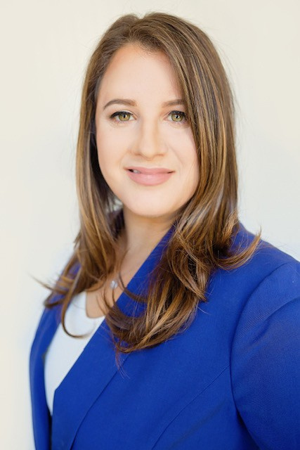



Presenter:
ELLI CONSTANTIN, M.Ed.
Distance Education Director, Cypress College
AI Special Advisor Accessibility, The Digital Innovation and Transformation Center
Professional Expert, CVC@ONE

Slide 3

The Reality of Our Student Body
The California Community College system serves an incredibly diverse population of learners, each bringing unique strengths, challenges, and needs to our classrooms. Understanding this diversity is crucial for creating truly inclusive educational environments.
2.2M
116
120K+
Total Learners
Colleges
DSPS Services
Students across the entire CCC system
Individual institutions serving communities statewide
Students receiving disability support services annually
These numbers tell only part of the story. Research suggests that 15 -20% of our students may be neurodivergent, experiencing conditions like ADHD, autism, or dyslexia that significantly impact their learning experience.
Source: National Center for Education Statistics, 2022
Elli Constantin, M. Ed. 2025 CC-BY
Notes:
Let’s provide context-
Executive function impairment
15-20% large population of students- only 120k receiving services.
Population of students unsupported

Slide 4



Do not edit How to change the design
How many of you have worked with a student who was clearly struggling, but was not formally identified with a disability or receiving DSPS support services?
The Slido app must be installed on every computer you’re presenting from
Notes:
What have you seen? What has been your experience in the classrooms?

Slide 5


The Hidden Population
The Disclosure Gap
Perhaps most striking is what we don't see: approximately 60% of students with disabilities do not disclose their needs to institutional support services.
Why Students Don't Disclose:
Stigma and fear of discrimination
High cost of professional evaluation
Limited access to diagnostic testing
Lack of awareness about available services
Previous negative experiences with disclosure
Key Insight: Variability is the rule, not the exception—our classrooms are filled with diverse strengths and needs, many of which remain invisible to traditional support systems.
Many of these students struggle with executive functioning challenges including difficulties with focus, planning, and time management—skills essential for academic success. Hidden Curriculum
Elli Constantin, M. Ed. 2025 CC-BY
Notes:
Let’s look at some more revealing numbers-
Variability in our classrooms is the norm, not the exception. Our new normal.

Slide 6



From Accommodation to Anticipation
Traditional Model
Reactive approach requiring individual disclosure
Wait for student to identify need
Require documentation
Provide specific accommodations
Retrofit existing content
AI-Enabled Shift
Proactive, inclusive design from the start
Anticipate diverse needs
Build accessibility into creation
Benefit all learners
Design for flexibility
Core Principle: AI is not replacing human connection—it amplifies our ability to meet every student where they are.
Elli Constantin, M. Ed. 2025 CC-BY
Notes:
Traditional DSPS Model
Incredibly valuable! Students that require accommodations that extend beyond traditional accessibility.
Document heavy
Many students wait to get services- negative self-assessment
AI-Pivot
Proactive
Intentional from the inception
Anticipatory
Turns accessibility from a perceivable burden to an attainable opportunity

Slide 7
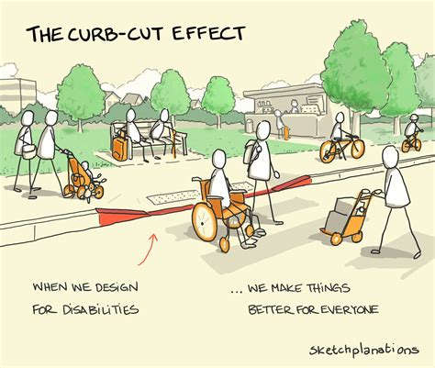
The Curb-Cut Effect
When we design with the needs of people with disabilities in mind, we often improve usability and convenience for all users.
This is the foundation of Universal Design — creating flexible environments, products, and systems that anticipate human diversity rather than react to it.
Notes:
I often hear, why do all this work if I may only have one or two students who benefit from it? It is a lot of workl.
Highlights the reality that the work you put into content remediation and accessible course design will benefit not just a few but all students.
Other examples:
Accommodation Originally Designed For Benefits For Everyone
Closed Captions Deaf or hard-of-hearing users Viewers in noisy spaces, language learners, people multitasking
Automatic Doors People using wheelchairs Shoppers with hands full, parents with strollers
Voice Recognition / Siri / Alexa People with mobility or vision disabilities Drivers, cooks, anyone preferring hands-free use
Text-to-Speech & Audiobooks People with visual or learning disabilities Commuters, auditory learners
High-contrast visuals & clear fonts Low-vision users Everyone using devices in bright light or on small screens
How can AI help?

Slide 8


AI: Powerful Tool, Not Replacement
Human Judgment Still Crucial
AI cannot replace human decision-making; outputs must be verified for accuracy and relevance.
Accessibility knowledge is Still Critical
AI use does not replace the need for accessibility and design knowledge. Always check AI!!
Notes:
Before I show you some tools, I want to preface with this. AI IS A TOOL- IT IS NOT YOUR REPLACEMENT
YOU STILL ARE STILL THE CAPTAIN OF THIS SHIP
AI makes mistakes
Still requires a foundational knowledge of accessibility.
Always check AI!

Slide 9
AI UDL TOOLS
Ludia AI – UDL Chatbot
Supports Universal Design for Learning (UDL) principles
Helps create inclusive, accessible course content
Universal Access Bot – UDL & Accessibility Chatbot
Makes content UDL-friendly
Revises materials for Canvas accessibility (WCAG 2.1 AA)
POCR-aligned and adds Canvas usability styles
Enhances accessibility and inclusive design
Adapts assignments and materials for diverse learners
Converts PDF to HTML
Generate image descriptions or alt text
Styles for improved readability
Gemini (Google)
Promotes engagement and authenticity through video, image, and story generation
Helps format and simplify content for students
Supports executive functioning and metacognition (e.g., “Review my weekly schedule and suggest study times”)
Search @OpenStax or @Youtube
NotebookLM
Summarizes and synthesizes course materials into clear, student-friendly versions
Builds engagement through podcasts and videos (verify accessibility)
Hemingway AI
Adjusts writing to match various reading levels for clarity and comprehension
Accessible Syllabus Bot
Converts any syllabus into an accessible, student-friendly format based on the Accessible Syllabus Project (Tulane University)
Notes:
Two items I want to show you, but I invite you to explore every resource I provide on these slides. First, Universal Access Bot- show how it can revise an assignment.
Then, Accessible syllabus bot.
Gemini also in Adobe Photo shop

Slide 10
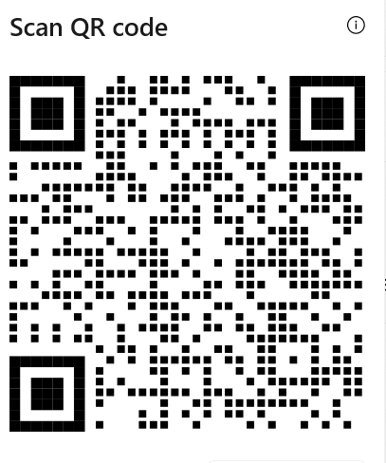
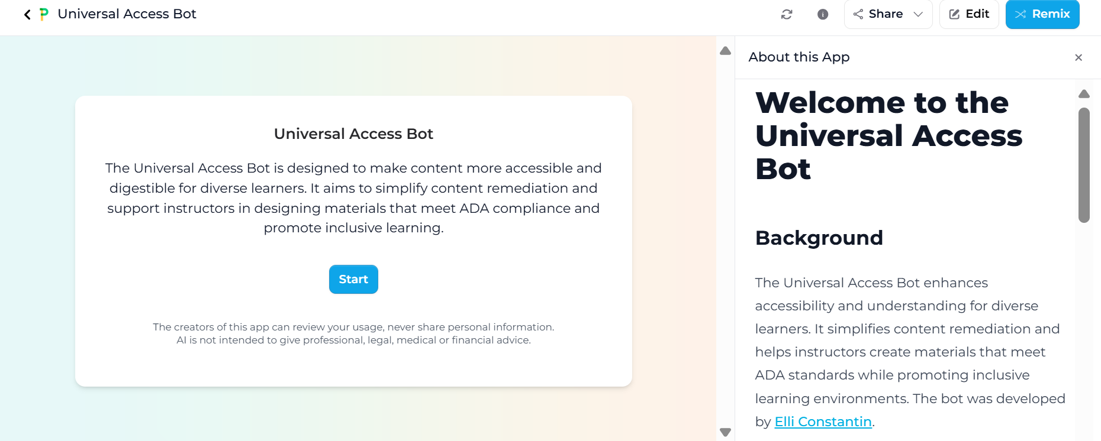
Universal Access Bot
PlayLab AI Universal Access Bot
Notes:
Trained on UDL guidelines 3.0, trained on making content accessible for Canvas, and the OEI rubric. It is aware of specific coding limitations in Canvas and how to make it accessible. It can also use HTML to format and organize using an interactive components like tabs or expanders. Trained in WCAG 2.1 AA

Slide 11
Read & Reflect: Interests in Functional Areas of Business
Read Chapter 2 of Foundations of Business (PDF download below) to learn about the five functional areas of business—, and finance. management, operations, marketing,and accounting.
After reading, choose one area that interests you most or that you might consider as a future career. In your response, explain why this area appeals to you, such as the type of work it involves, the skills it uses, or how it contributes to a company’s success. Then, include three thoughtful questions you have about that functional area or careers related to it. Your paragraph should show understanding of the topic and curiosity about how different business functions work together.
Chapter 2 Foundations of Business
Assignment
Notes:
Image source: Microsoft 365 content library The five functional areas of business include operations, which focuses on producing goods and services efficiently. Reading Chapter 2 from the Foundations of Business textbook introduces each area’s importance for organizational success. Reflect on how operations interacts with other business functions and answer the related reflection question at the end of the reading.

Slide 12

Sample AI Prompts:
Revise this assignment to improve accessibility and ensure alignment with Universal Design for Learning (UDL) guidelines. Make directions clear, inclusive, and flexible for diverse learners.
Revise this assignment for accessibility and provides extra clarity and support for a student who struggles with organization and reading comprehension.
Revise this assignment for accessibility and to make it easier for ESL students to understand and complete. Use clear, simple English and define key terms. Include examples or visuals, provide sentence starters, and allow short or audio responses. Encourage personal or cultural connections.
If you don’t know where to start? Just ask the bot!
Notes:
The bot is trained in UDL, WCAG 2.1AA, Canvas codes for styles, and POCR. No special prompting needed.
Accessibility and UDL in MIND
Executive functioning or specific targeted learning needs
Support English language learners in your class, or students who struggle with language or visual processing.

Slide 13
DEMO
Conversation Response

Slide 14
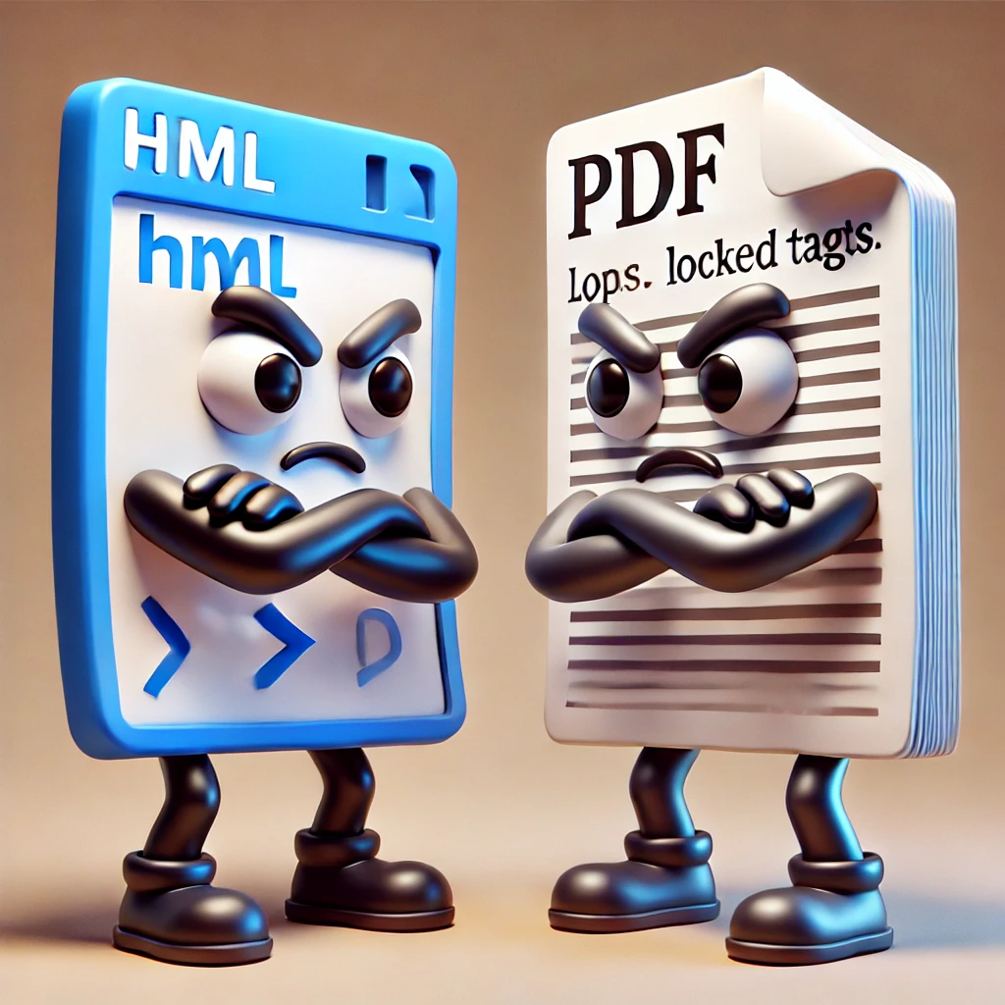
Convert PDFs to HTML for Canvas
Upload PDF into a bot (I used Universal Access Bot)
Prompt: Convert to accessible HTML for Canvas
Bonus:
Remediate for UDL
Simplify the language
Provide real-world examples, etc.
Organize using tabs or expanders
Chapter 2 PDF download
OpenAI. HTML and PDF Page Staring Angrily. DALL·E, 2025.
Notes:
Remember that PDF I asked students to download? What is the issue with PDFS?
HTML easy to make accessible, also less clicks, less cognitive load keeping it all within Canvas.

Slide 15
DEMO 2
Conversation Response

Slide 16

Universal Rubric Designer for Canvas
Growth Mindset Rubrics frame learning as ongoing development rather than fixed ability.
Encourages persistence and reflection (UDL: Engagement).
Positions feedback as a tool for progress and self-efficacy.
Clear Performance Levels Four distinct tiers—Not Yet Competent, Partly Competent, Competent, and Sophisticated—describe observable progress.
Provides multiple entry points for learners (UDL: Representation).
Makes expectations transparent and inclusive.
Actionable Feedback Uses specific, measurable language and clear next steps for improvement.
Promotes metacognition and self-regulation (UDL: Engagement & Expression).
Reduces ambiguity that can disadvantage diverse learners.
Alignment with Learning Goals Each criterion connects directly to defined learning outcomes.
Clarifies purpose and relevance (UDL: Representation).
Helps learners focus on essential skills and knowledge.
(Adapted from Linda Suskie, Assessing Student Learning: A Common Sense Guide)
Notes:
Rubric
Equitable, UDL driven, growth orientated
Linda Suskie
Supports metacognition- learning tool, not a grading tool.
Clear growth orientated performance levels
Actionable feedback that encourages growth with NEXT STEPS that encourages students to persist, and shows them HOW to persist. Removes the mystery
Connects directly with learning goals

Slide 17
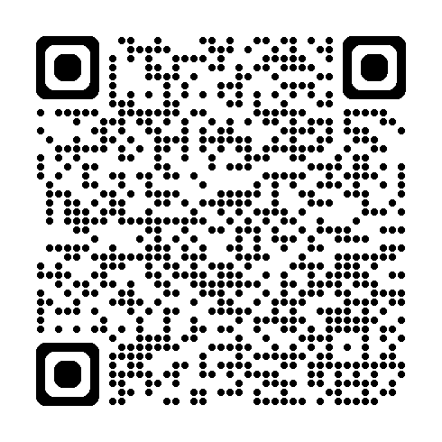
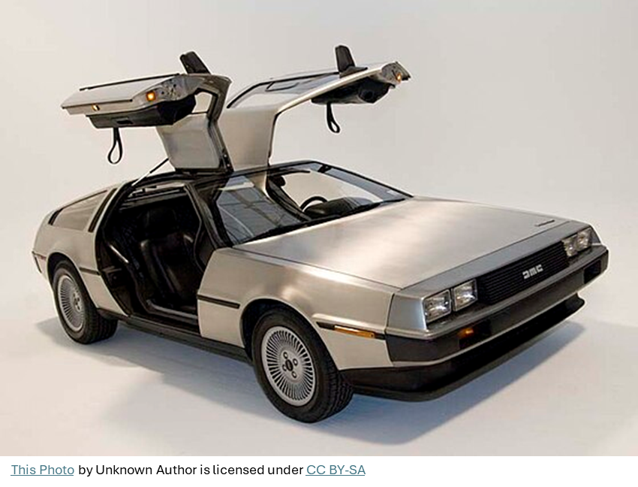
Universal Rubric Designer
Sample Assignment rubric generation
Rubric Designer BOT
Notes:
Make sure to enable “Enhanced Rubrics” in settings

Slide 18
Demo 3
Chat Convo
File
https://1drv.ms/x/c/8b57d67d94fb1ddc/EZblNwyRsE5Ig4Q7SMdktg4Bdk0fYkdBTTektUx6lSvSFg?e=rHVbSy
Rubric uploaded
Notes:
Flexible, equitable, clear rubrics that can be modified and created within minutes.

Slide 19
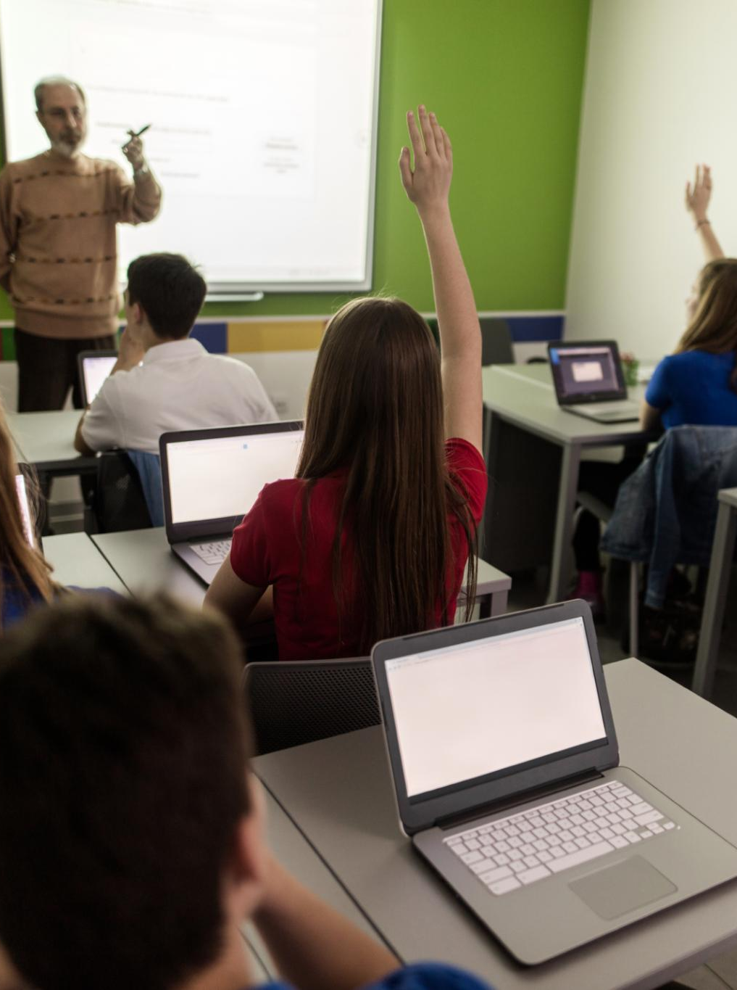
Call to Action
Plus One Theory
START WITH ONE TOOL
Choose one new tool or strategy to enhance an assignment, content page, or rubric — making learning more accessible for all students.
ENHANCE ACCESSIBILITY
Small updates can improve access and engagement for diverse learners, supporting Universal Design for Learning (UDL).
You don’t have to change everything now to make a big impact.
EVALUATE AND GROW
Reflect on the results, celebrate progress, and keep evolving your teaching practices toward greater inclusivity.
Tobin, T. J., & Behling, K. T. (2018). Reach everyone, teach everyone: Universal design for learning in higher education. Morgantown, WV: West Virginia University Press.
Notes:
Image source: Microsoft 365 content library Commit to the PLUS ONE approach by choosing one new tool to revise a single assignment or content page for Universal Design for Learning (UDL). This small step enhances accessibility, engages diverse learners, and fosters inclusive practices. Start with one change, evaluate its impact, and build confidence to continue transforming your teaching.
You don’t have to change everything now to make a big impact.
Don’t forget to celebrate your progess!

Slide 20
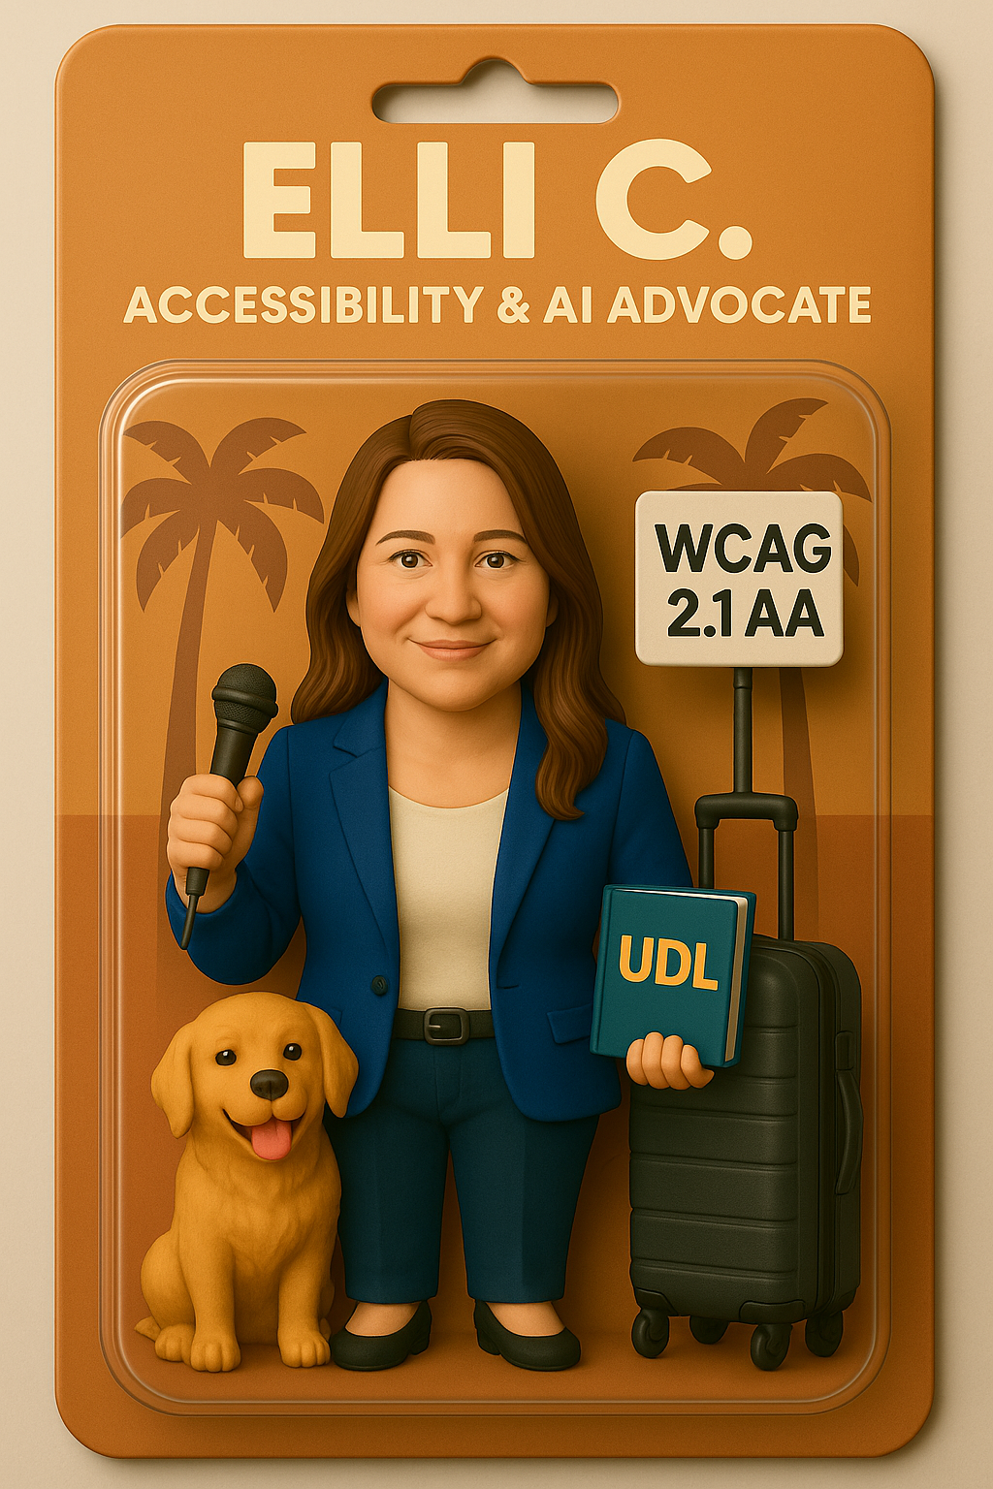
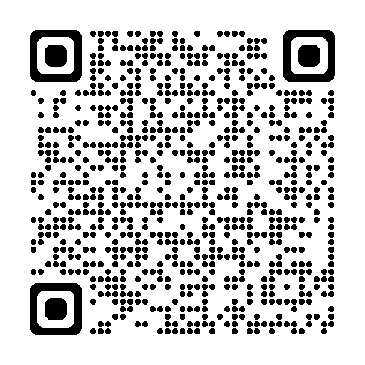
Let’s Connect!
Advisor Work:
Evaluate Accessibility of AI tools
Contact:
econstantin@cypresscollege.edu
LinkedIn:

